Slide 1



Science Writing at UANews
Rebecca Peiffer
Mentors: Robin Tricoles and La Monica Everett, UANews
Arizona Space Grant Symposium
Hosted by the University of Arizona
April 16, 2016

Slide 2
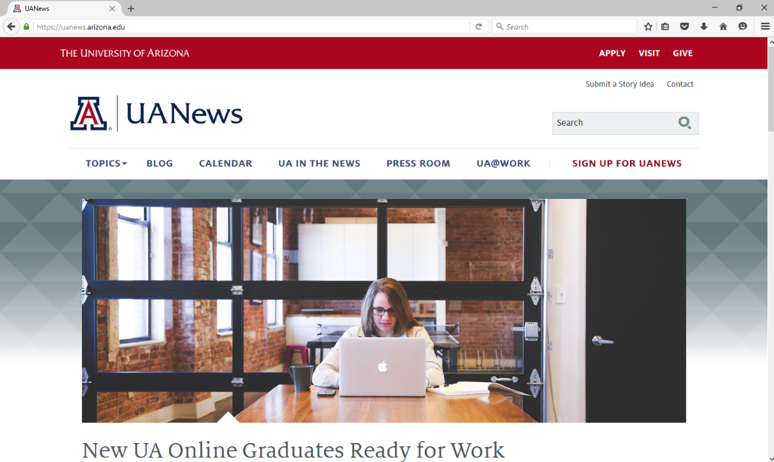
UANews
Governing Department: University Relations – Communications
“First point of contact for news and information about the University of Arizona.”
Science writing in particular shares research with the public
Land Grant mission
Source: uanews.arizona.edu

Slide 3
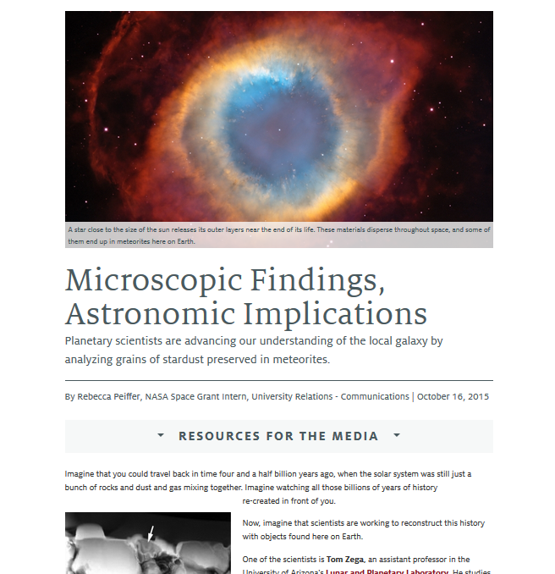
The Idea for a Story
Where can we get ideas?
Reading faculty publications
Story ideas from readers
Partnerships with various departments
Remember: there are many possible story angles for any given story idea
Source: uanews.arizona.edu

Slide 4
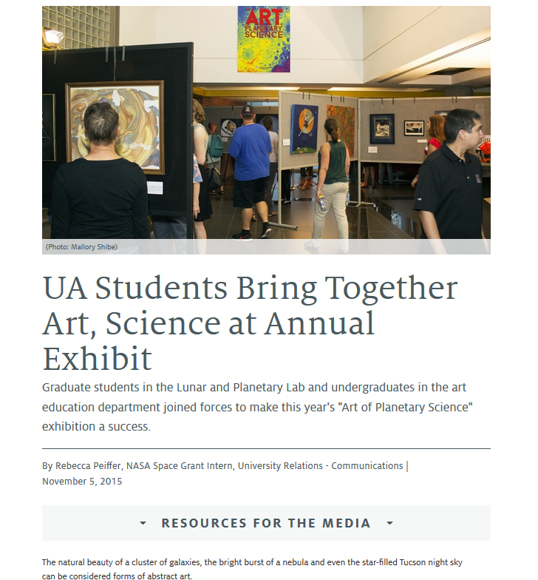
Research Stage
Reach out to initial contacts
Look up basic information online
Attend event and take extensive notes
Conduct interviews
Source: uanews.arizona.edu

Slide 5
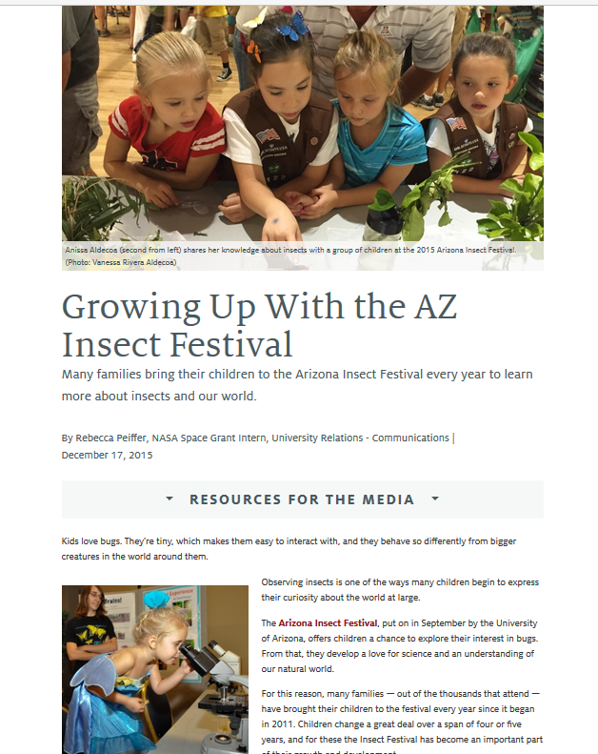
Interview Stage
Who to interview?
Main researcher
UA faculty in related fields
UA students
Event organizers
Event attendees
Source: uanews.arizona.edu

Slide 6
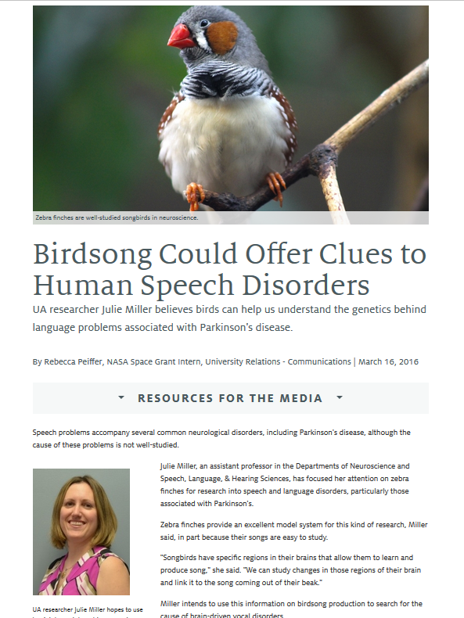
Drafting Stage
Organize research
  Transcribe interviews
  Add detail to event notes
  Decide what is most important to include
  Outline story
Start writing!
  Catchy introduction → Nut graf
  Keep story angle in mind
  Find and credit good pictures
Edit, edit, edit!
  Check for clarity
  Follow-up with contacts
Source: uanews.arizona.edu

Slide 7
End Goal: Publication
To date, I have published 7+ science stories through UANews
Original Goal: Promote the hard work of scientists and researchers
This internship has taught me science is everywhere
  Faculty and student research
  Science-based art
  Science festivals
Additional Goals:
  Make research available and understandable to the public
  Foster a spirit of inquiry amongst all people, regardless of scientific background

Slide 8
Acknowledgements
Mentors: Robin Tricoles & La Monica Everett
UANews Staff and University Relations – Communications
NASA Space Grant Mentors: Susan Brew, Chandra Holifield Collins, and Mary Jones
NASA Space Grant Program
…and everyone here to watch us present. Thank you all for your incredible support at every step of the way!

Slide 9
Thank you!

